Slide 1
VBU Staff Meeting
3-4-12

Slide 2
Agenda
“Bucknell Today!” Update
Music Blocks
Double Take
Peer Criticism
Upcoming Outside Calls
Website
Tip of the Month
Go Home

Slide 3
“Bucknell Today!” Update
Past and Upcoming

Slide 4
Music Blocks
Charlie Geitz

Slide 5
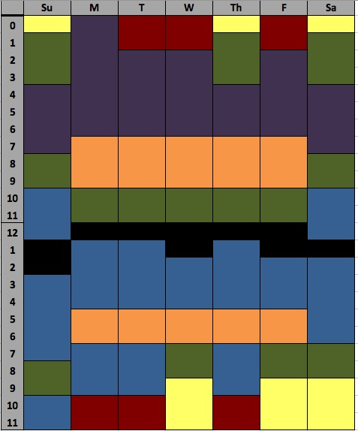
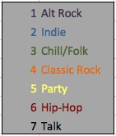

Slide 6
Double Take
Story of the Day

Slide 7
Now: Find the Host(s)
"Genetically Modified Beats” = "Midnight Gathering
"World of Zion" = "Balderrama"
"Simple Living With David R-K" = "The Rock Underground"
"In Good Gear" = "Those Damn Jackolopes"
"Hustlin' Backwards" = "Split Second"
"Show Without Honor Or Humanity" = "Bacterial Culture"
"You Can't Handle This" = "The Raff Underground"
"Culture Shock" = "Weekend Kickoff"
"Pregame With Miller" = “Pete And Prez's Country Corner”
"Prime Time Warm-Up" = "Senioritis"
"Arcosanti" = "Semiotic Anthems"

Slide 8
Peer Critics!
Charlie Geitz

Slide 9
Upcoming Outside Calls
2 BIG ones
April 7th: Festival on the Quad
April 28th: Relay for Life
Possibility of being paid
MAJOR Merit points
Chance to learn about live sound

Slide 10
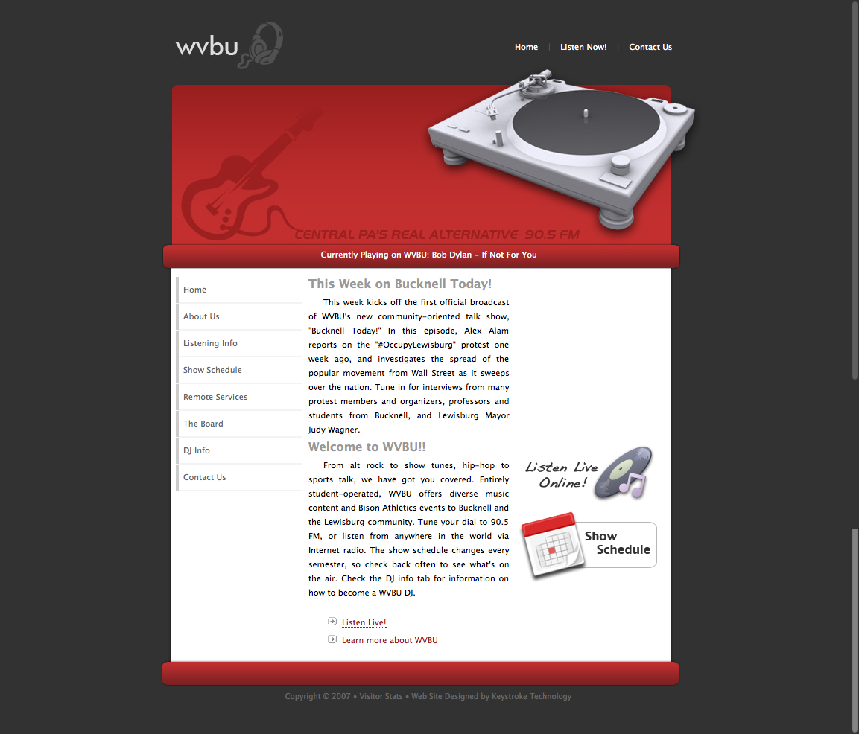

Slide 11
Tip of the Month
Aaron Vockley

Slide 12
Other Updates?
Anyone?

Slide 13
GO HOME

